Slide 1
2012 Seattle National Homebrewers Conference Overview & Participation Invitation
Washington Homebrewers Association
Mark Emiley
Tom Schmidlin

Slide 2
2012 NHC – Seattle Bellevue
In late 2009 the Washington Homebrewers Association put in a bid for the 2012 conference
In June of 2010, AHA decided on Seattle for the 2012 Conference from June 21st to 23rd at the Bellevue Hyatt
  Weekend AFTER Father’s Day
  Conference Chairs: Mark Emiley & Tom Schmidlin
One of the earliest decisions ever, giving Washington a unique ability to plan well in advance

Slide 3
Why it Matters to Homebrewers and Clubs
First ever conference held in Washington!!!
  Last “Northwest” conference was 15 years ago in Portland
  Won’t be coming back to Washington for a long time
Chance to exhibit Washington’s homebrewing culture
  Washington is stuck up in the corner of the country – don’t get too many chances to “get out”
Great opportunity to get feedback on your beers from a wide range of homebrewers
Chance to recruit new local “independent” homebrewers
  Find those brewers that have been hiding right around the corner and let them know what your club is about
Once in a “brewtime” opportunity to have the largest gathering of brewers in our own backyard
  No travel expenses or delays! $$$
    Don’t have to fly to have an incredible weekend
  Ease of beer transportation (no long-distance logistical complications)

Slide 4
Conference Overview
~1,600 of the country’s biggest beer dorks
  Participants from all over the country
  Chance for the homebrewing community to get together, celebrate the hobby, and experience the ultimate camaraderie
Core conference is 3 days (Thursday-Saturday)
  Culmination of National Homebrewers Competition
  Technical/practical conference for homebrewing
  Nightly festivals with Club and Pro Brewers Nights
  Grand Banquet to wrap up conference
Pre-conference events held beforehand
  Bus tours
  Beer dinners
  BJCP Reception
  Brewing Network Anniversary Party

Slide 5
Pre-Conference Events
Tuesday and Wednesday have bus tours running from the hotel to local breweries
  Tour the brewery, meet the brewers, try some beers
  You may have been to the breweries on your own before but this is a chance to visit them with people from all over the country and experience them in a new light
Likely to have beer dinner events
While these events are targeted towards out-of-state brewers, we want you all to enjoy them as well
We can use help on the tours so let us know if you would be up for helping to host a bus tour
POC: Joanne Collier

Slide 6
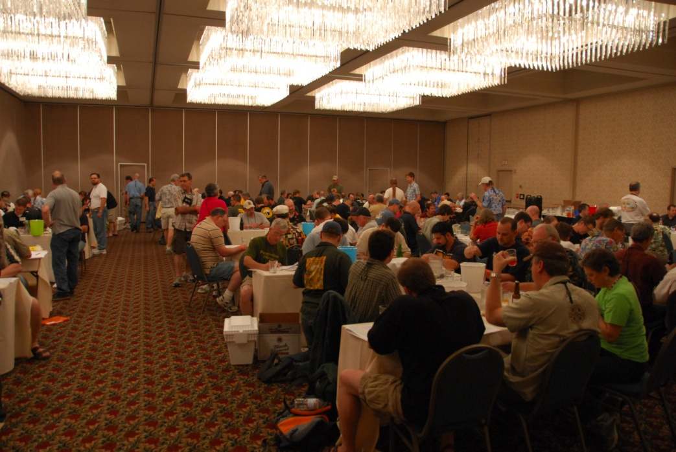
National Homebrewers Competition Final Round
Final round of the NHC will be held on Thursday
THIS IS OUR BEST CHANCE TO TAKE MAKE THE MOST OF HOMEFIELD ADVANTAGE!
  Encourage your club to shotgun the first round of the NHC
  More entries in = more entries through
We will be looking for judges and stewards to help run the competition
  Great chance to learn about judging and the competition process
  Meet some of the best judges
  out there
Great time, best homebrews in the
country, and the most intense
competition in the world
Competition POC: Tim Hayner

Slide 7
Conference – Beginning (Thursday)
National Homebrewers Competition Judging
Conference begins at noon
Educational seminars begin in the afternoon
  1 hour sessions
  Typically run 3 seminars at a time
  Continue through Saturday afternoon
  Friday afternoon: Keynote Speaker Address

Slide 8
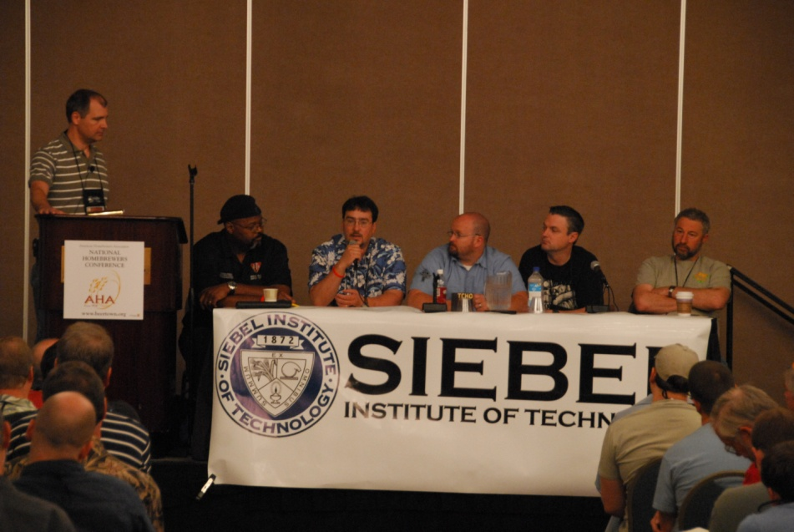
Speakers
Industry experts, craft brewers, and homebrewers give talks on various topics
  Ingredients, processes/techniques, styles, experiments, whatever
Likely topics:
  Going pro panel
  Hop panel
  Yeast advanced topics
  Equipment
  Meads and ciders
Is there an experiment that you might be willing to participate in or a topic you have an advanced speaker for? Let us know!
Speaker POCs: Denny Conn, Mark Emiley, Tom Schmidlin

Slide 9
Hospitality Suite
During the conference, different clubs take turns at the “hospitality suite” serving their best homebrews
  Opportunities to sponsor a session and get great visibility for your club
Typically serve a 2-3 hour shift
Jockey boxes provided
Just need 6-12 beers to serve and 2-6 people to volunteer for your shift
Can merge up with another club if you don’t feel that you have enough support
We need as many local clubs as possible to host a shift
  A lot harder for out of state brewers to get beers here
Hospitality Suite POC: Mark Tanner

Slide 10
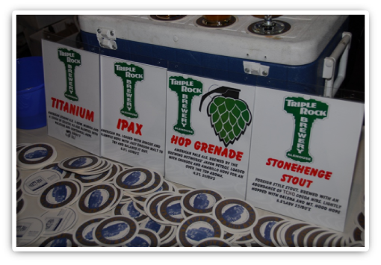
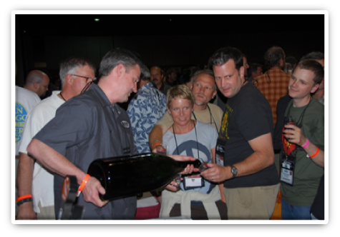
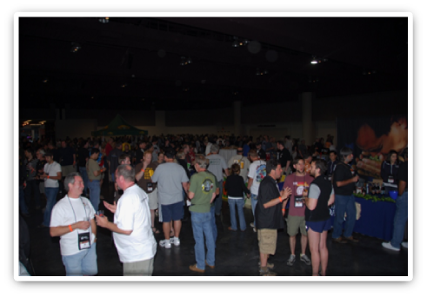
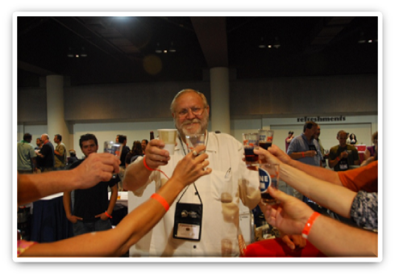
Conference – Thursday Night
Pro-Brewers Night
Craft brewers get to showcase their best beers to homebrewers from across the country
  Brewers send great beers and brewery reps
  Private beer festival

Slide 11
Club Night – Friday Night
Beerstock 5060-like homebrew festival with clubs hosting booths serving club beers
  Like a craft beer festival filled with the most passionate brewers and attendees
Each participating is given booth space to serve the best beers from their club members
  Show off someone’s fantastic pilsner or crazy specialty beer
  Booths can be decorated to express each club’s unique personality
  Members frequently wear themed costumes

Slide 12
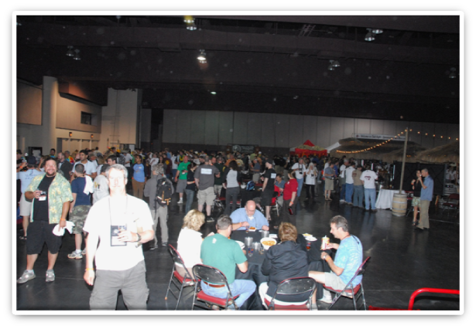
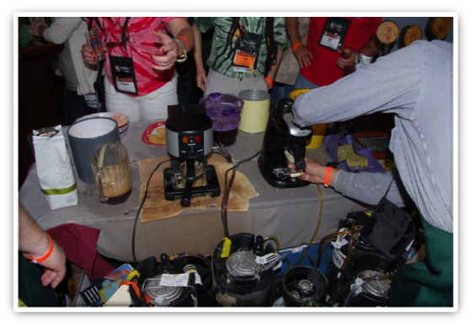
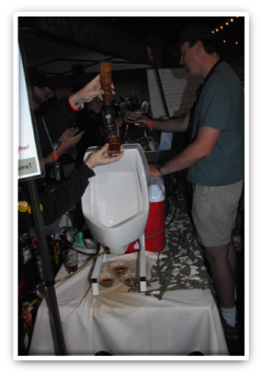
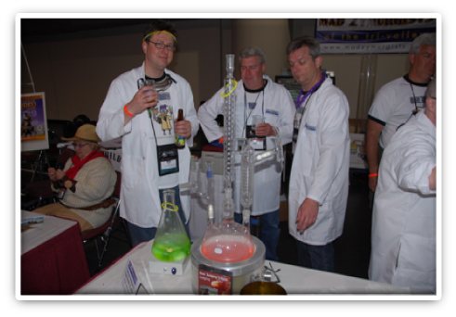
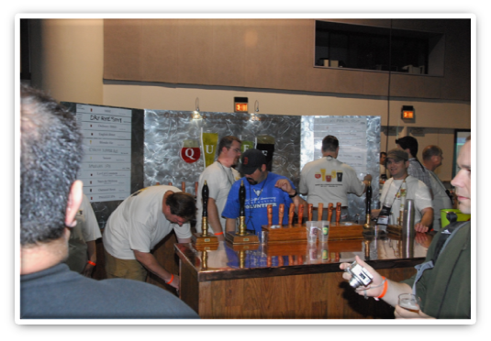
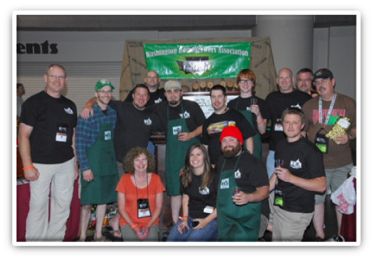
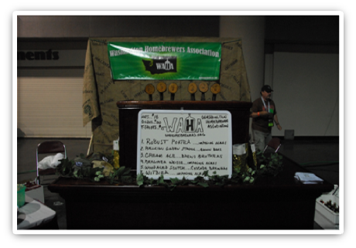
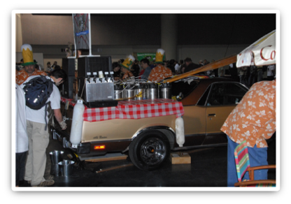
Club Night Photos

Slide 13
How to Prep for Club-Night
Most clubs develop a fun themed booth of some sort
  Many clubs showcase some sort of fun regional cuisine
  Unique serving presentations are appreciated
Bring a billboard of what beers are serving
Consider building a club jockey box or even stranger beer serving apparatus
  Ice will be provided
Bring as many great, delicious, exciting, and innovative beers as possible
  Start brewing today!!!
  Barrel project?

Slide 14
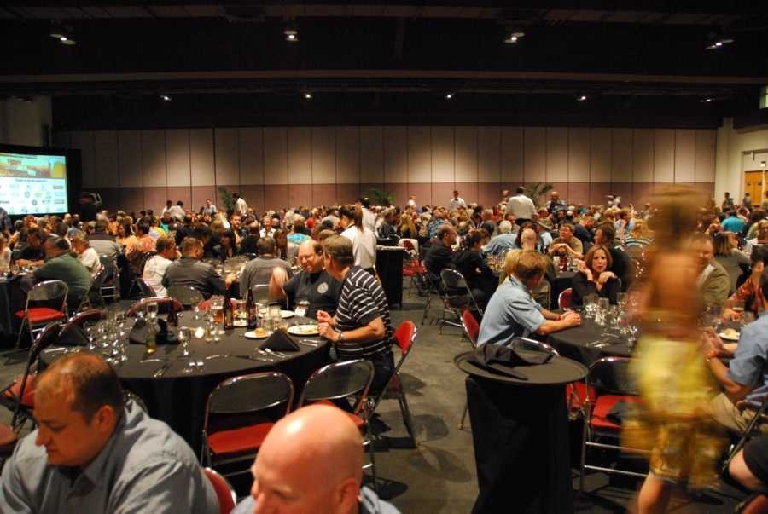
Grand Banquet
Culmination of conference and awards ceremony for the National Homebrewers Competition
Beer dinner sponsored by Rogue and designed by Sean Paxton (the homebrew chef)
  Special courses and beer pairings
Space will be limited so make sure to get your ticket early!!!

Slide 15
Attendance
You will get very few chances to attend a conference this close to home, so take advantage of the prime location
The full conference package was $230 in 2011 (plus any lodging or pre-conference expenses) and should be similarly priced this year
  That includes 3 days of lectures, access to the hospitality suite, Pro Brewers Night, Club Night and the Banquet
The conference will sell out, so be prepared to purchase your tickets early
  Tickets go on sale in February and will likely be sold out in less than a month
There are cheaper packages available which include mainly social functions, but the whole conference experience is something not to miss and is a great chance to expand your brewing knowledge

Slide 16
Opportunities for Club Participation
Attendance
  Washington homebrewers typically don’t make it out to conferences – THIS IS THEIR EASIEST CHANCE TO EXPERIENCE ONE
Volunteers
  We need help on many dimensions of the event – please encourage members to consider volunteering to serve on a committee – lots of fun and the best “community service” you will ever do*
Hospitality Suite
  Manning a shift for 2-3 hours
  Need roughly 6-10 beers, 2-4 people at least to help cycle
Club Night
  Get as crazy as you can, bring as many club members as you can and as many kegs (as you are legally allowed to bring, of course ☺)
* Volunteering will not count for court mandated community service, especially for DUIs ☺

Slide 17
Our Hope for Your Club’s Participation
You are around during the conference
  Lots of enthusiastic people interested in meeting you and tasting your beers
  If there are things you want to organize, let us know about them so that we can point people towards you
You’d like to be a part of the event
  Trust us, you NEED to participate in Club Night
  We need local support for the hospitality suite, speakers, volunteers, and tour planning
We’ve got lots of time to plan, prepare, and brew! Start early!

Slide 18
What Your Club Should Do To Prepare
Plan to take Thursday and Friday off if possible
  At least people should get tickets for Friday night / club night – trust us
  This is a one-time shot for the conference, they won’t regret the vacation time
Brew great beers
  Both for the hospitality suite and club night
Form a committee or designate a focal to help coordinate your club’s participation
  A little coordination goes a long way!
Sign up for club night and/or the hospitality suite
  Club night is a priority, but we also need clubs to sign up for short shifts to help carry the load
Think about a club theme for club night (decorations, costumes, food, etc.)
  Not necessary but definitely draws attention
Think about serving equipment
  Jockey boxes are a worthwhile investment; however, your beer should come to you cold and will just need to be served for about 4 hours
Get as many club members as you can to come to the conference
  Great experience and great opportunity to meet prospective club members

Slide 19
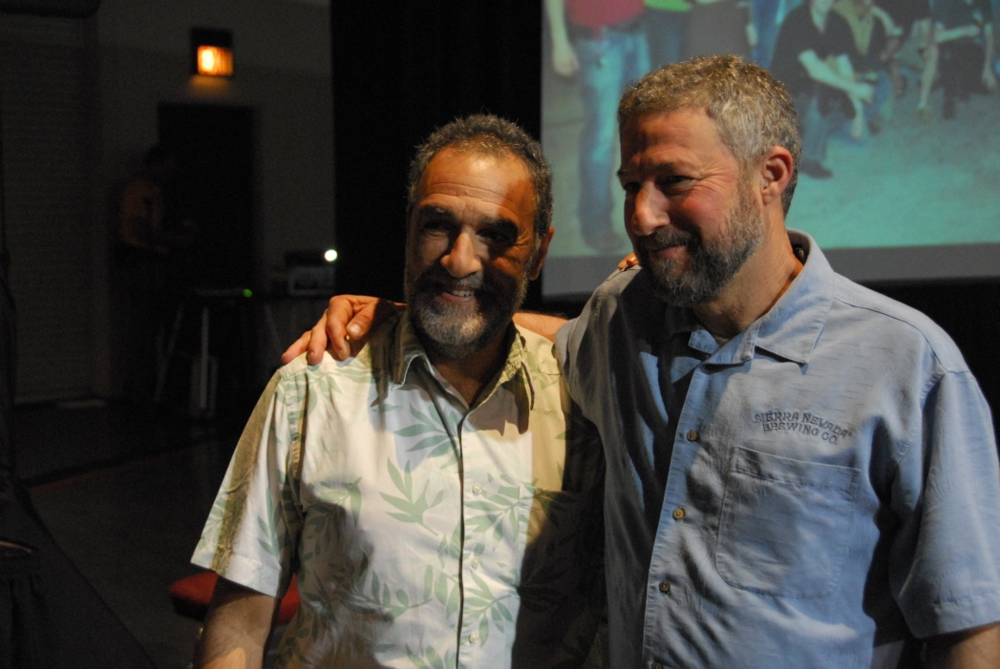
Summary
June 21-23, 2012, Bellevue Hyatt
  One time deal – won’t be coming back for a looooong time
Looking for interested homebrewers and clubs to start planning ahead
  Brew some great beers and come up with some great booths
If you are interested in ANY part of the conference, let us know now and we’ll start keeping you in the loop as things progress
mark@wahomebrewers.org
www.wahomebrewers.org
www.ahaconference.org
You can find more information from the local committee at: www.brewingwithbigfoot.com
We want to show off your Washington homebrew!

